Slide 1
Announcements
Project 3 is due Tuesday, February 28, 11:59 PM PT
HW3 is due Friday, February 17, 11:59 PM PT

Slide 2
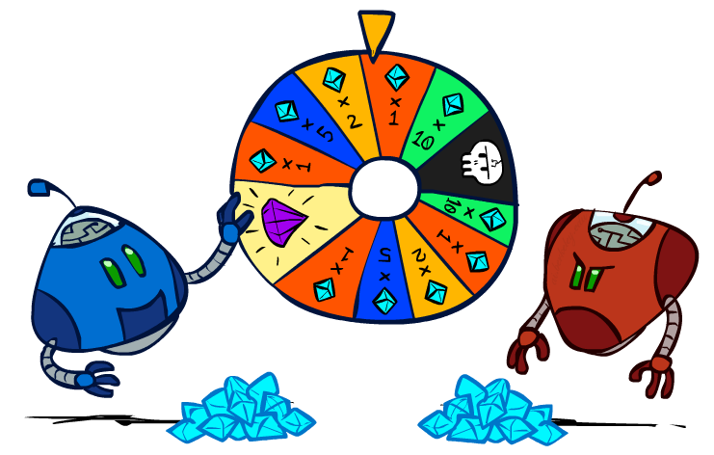
CS 188: Artificial Intelligence
Expectimax, Monte Carlo Tree Search
Spring 2023
University of California, Berkeley
[These slides were created by Dan Klein, Pieter Abbeel for CS188 Intro to AI at UC Berkeley (ai.berkeley.edu).]
Notes:
Please retain proper attribution, including the reference to ai.berkeley.edu. Thanks!

Slide 3
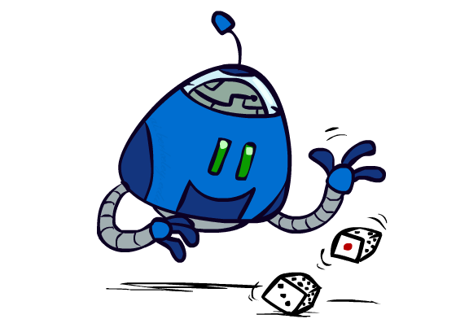
Uncertain Outcomes

Slide 4
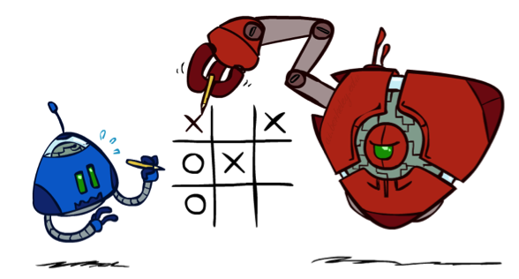


Worst-Case vs. Average Case
max
min
10
10
9
100
Idea: Uncertain outcomes controlled by chance, not an adversary!
Notes:
At least 10, or otherwise just rather dead; or just 100, or otherwise rather dead; that’s yet something different than minimax or expectimax

Slide 5
Expectimax Search
Why wouldn’t we know what the result of an action will be?
Explicit randomness: rolling dice
Unpredictable opponents: the ghosts respond randomly
Actions can fail: when moving a robot, wheels might slip
Values should now reflect average-case (expectimax) outcomes, not worst-case (minimax) outcomes
Expectimax search: compute the average score under optimal play
Max nodes as in minimax search
Chance nodes are like min nodes but the outcome is uncertain
Calculate their expected utilities
I.e. take weighted average (expectation) of children
Later, we’ll learn how to formalize the underlying uncertain-result problems as Markov Decision Processes
max
chance
10
10
4
10
5
9
7
100
[Demo: min vs exp (L7D1,2)]

Slide 6

Video of Demo Minimax vs Expectimax (Min)

Slide 7
Video of Demo Minimax vs Expectimax (Exp)

Slide 8
Expectimax Pseudocode
def value(state):
if the state is a terminal state: return the state’s utility
if the next agent is MAX: return max-value(state)
if the next agent is EXP: return exp-value(state)
def max-value(state):
initialize v = -∞
for each successor of state:
v = max(v, value(successor))
return v
def exp-value(state):
initialize v = 0
for each successor of state:
p = probability(successor)
v += p * value(successor)
return v
Notes:
Pick an order for two reasons: sequential processor and pruning

Slide 9
Expectimax Pseudocode
def exp-value(state):
initialize v = 0
for each successor of state:
p = probability(successor)
v += p * value(successor)
return v
1/2
1/6
1/3
5
8
7
24
-12
v = (1/2) (8) + (1/3) (24) + (1/6) (-12) = 10

Slide 10
Expectimax Example
3
12
9
2
4
6
15
6
0

Slide 11
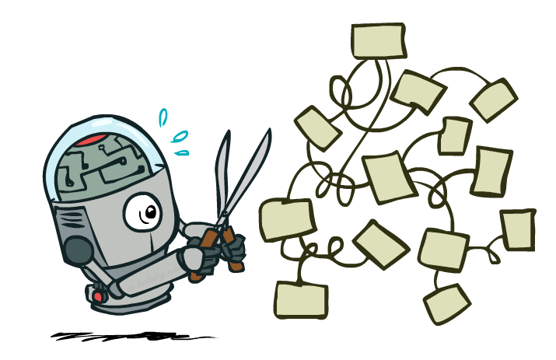
Expectimax Pruning?
3
12
9
2

Slide 12



Depth-Limited Expectimax
Estimate of true expectimax value (which would require a lot of work to compute)
400
300
…
…
492
362
…

Slide 13
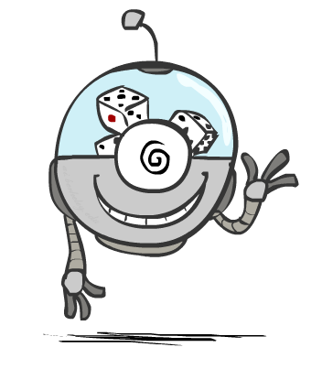
Probabilities

Slide 14
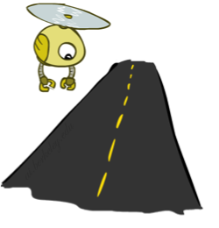
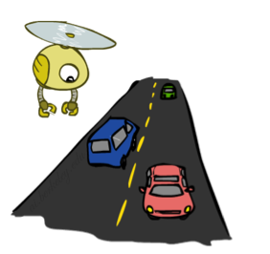
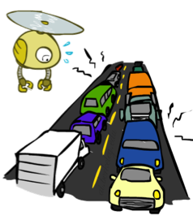
Reminder: Probabilities
A random variable represents an event whose outcome is unknown
A probability distribution is an assignment of weights to outcomes
Example: Traffic on freeway
Random variable: T = whether there’s traffic
Outcomes: T in {none, light, heavy}
Distribution: P(T=none) = 0.25, P(T=light) = 0.50, P(T=heavy) = 0.25
Some laws of probability (more later):
Probabilities are always non-negative
Probabilities over all possible outcomes sum to one
As we get more evidence, probabilities may change:
P(T=heavy) = 0.25, P(T=heavy | Hour=8am) = 0.60
We’ll talk about methods for reasoning and updating probabilities later
0.25
0.50
0.25

Slide 15
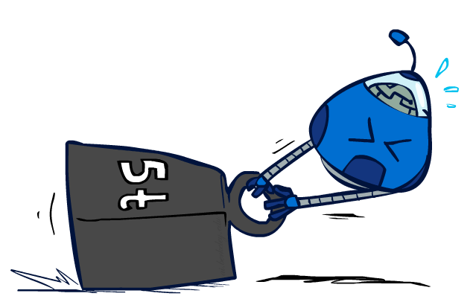
Reminder: Expectations
The expected value of a function of a random variable is the average, weighted by the probability distribution over outcomes
Example: How long to get to the airport?
Time:
20 min
30 min
60 min
+
+
35 min
x
x
x
Probability:
0.25
0.50
0.25

Slide 16

What Probabilities to Use?
In expectimax search, we have a probabilistic model of how the opponent (or environment) will behave in any state
Model could be a simple uniform distribution (roll a die)
Model could be sophisticated and require a great deal of computation
We have a chance node for any outcome out of our control: opponent or environment
The model might say that adversarial actions are likely!
For now, assume each chance node magically comes along with probabilities that specify the distribution over its outcomes
Having a probabilistic belief about another agent’s action does not mean that the agent is flipping any coins!

Slide 17
Quiz: Informed Probabilities
Let’s say you know that your opponent is actually running a depth 2 minimax, using the result 80% of the time, and moving randomly otherwise
Question: What tree search should you use?
Answer: Expectimax!
To figure out EACH chance node’s probabilities, you have to run a simulation of your opponent
This kind of thing gets very slow very quickly
Even worse if you have to simulate your opponent simulating you…
… except for minimax, which has the nice property that it all collapses into one game tree
0.1 0.9

Slide 18

Modeling Assumptions

Slide 19
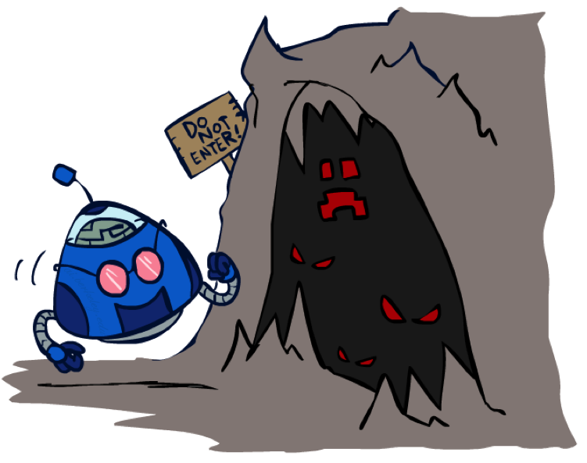
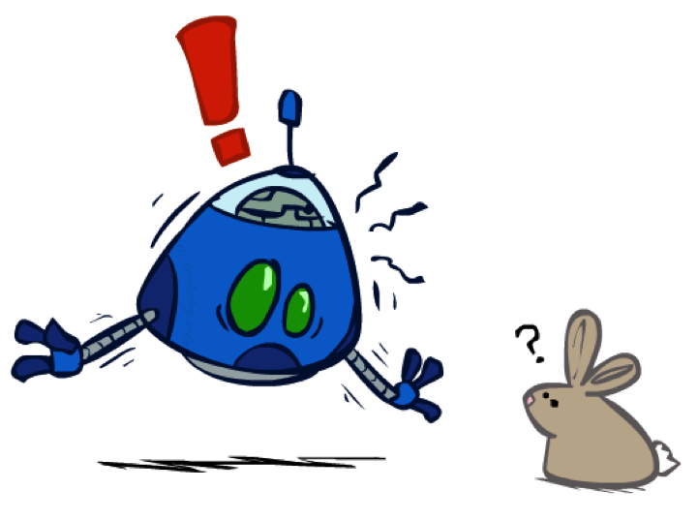
The Dangers of Optimism and Pessimism
Dangerous Optimism
Assuming chance when the world is adversarial
Dangerous Pessimism
Assuming the worst case when it’s not likely

Slide 20
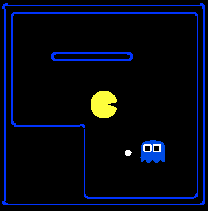
Assumptions vs. Reality
 | Adversarial Ghost | Random Ghost
Minimax Pacman | Won 5/5 Avg. Score: 483 | Won 5/5 Avg. Score: 493
Expectimax Pacman | Won 1/5 Avg. Score: -303 | Won 5/5 Avg. Score: 503
Results from playing 5 games
Pacman used depth 4 search with an eval function that avoids trouble Ghost used depth 2 search with an eval function that seeks Pacman
[Demos: world assumptions (L7D3,4,5,6)]
Notes:
python pacman.py -g SmartGhost -l trapped2 -p ExpectimaxAgent -a depth=4,evalFn=better

Slide 21
Assumptions vs. Reality
 | Adversarial Ghost | Random Ghost
Minimax Pacman | Won 5/5 Avg. Score: 483 | Won 5/5 Avg. Score: 493
Expectimax Pacman | Won 1/5 Avg. Score: -303 | Won 5/5 Avg. Score: 503
Results from playing 5 games
Pacman used depth 4 search with an eval function that avoids trouble Ghost used depth 2 search with an eval function that seeks Pacman
[Demos: world assumptions (L7D3,4,5,6)]
Notes:
python pacman.py -g SmartGhost -l trapped2 -p ExpectimaxAgent -a depth=4,evalFn=better

Slide 22
Video of Demo World Assumptions Random Ghost – Expectimax Pacman

Slide 23
Video of Demo World Assumptions Adversarial Ghost – Minimax Pacman

Slide 24
Video of Demo World Assumptions Adversarial Ghost – Expectimax Pacman

Slide 25
Video of Demo World Assumptions Random Ghost – Minimax Pacman

Slide 26

Other Game Types

Slide 27



Mixed Layer Types
E.g. Backgammon
Expectiminimax
Environment is an extra “random agent” player that moves after each min/max agent
Each node computes the appropriate combination of its children
Notes:
If it’s terminal or we reached our depth limit, return utility

Slide 28
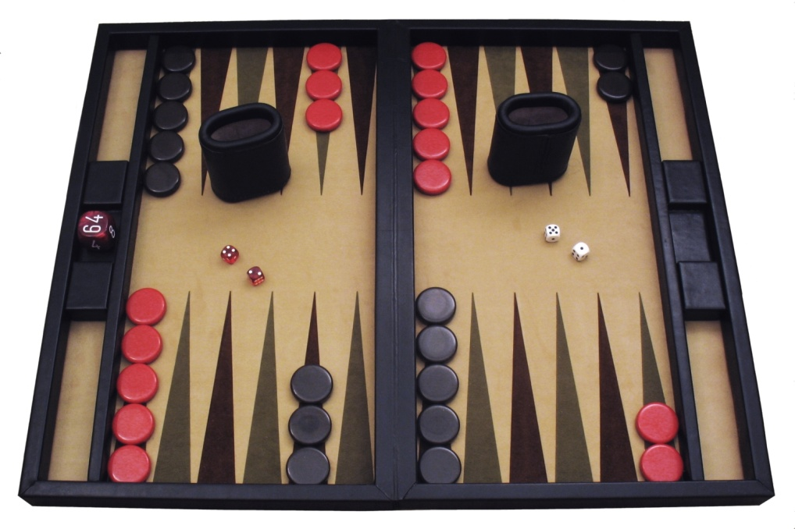
Example: Backgammon
Dice rolls increase b: 21 possible rolls with 2 dice
Backgammon ≈ 20 legal moves
Depth 2 = 20 x (21 x 20)³ = 1.2 x 10⁹
As depth increases, probability of reaching a given search node shrinks
So usefulness of search is diminished
So limiting depth is less damaging
But pruning is trickier…
Historic AI: TDGammon uses depth-2 search + very good evaluation function + reinforcement learning: world-champion level play
1st AI world champion in any game!
Image: Wikipedia

Slide 29
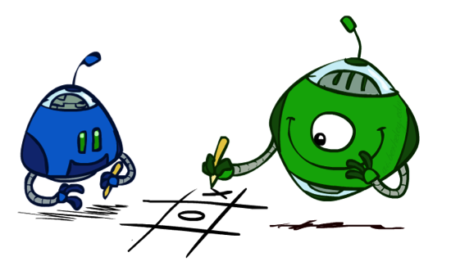
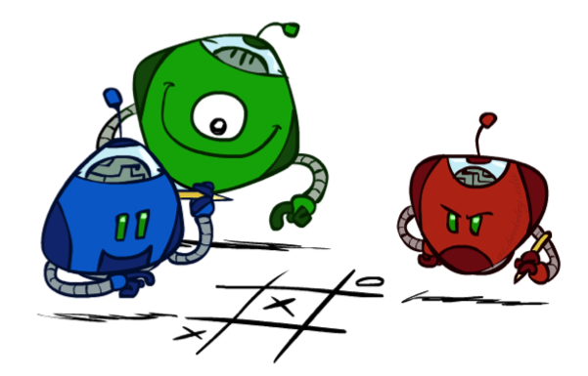
Multi-Agent Utilities
What if the game is not zero-sum, or has multiple players?
Generalization of minimax:
Terminals have utility tuples
Node values are also utility tuples
Each player maximizes its own component
Can give rise to cooperation and
competition dynamically…
1,6,6
7,1,2
6,1,2
7,2,1
5,1,7
1,5,2
7,7,1
5,2,5

Slide 30

Monte Carlo Tree Search

Slide 31
Monte Carlo Tree Search
Methods based on alpha-beta search assume a fixed horizon
Pretty hopeless for Go, with b > 300
MCTS combines two important ideas:
Evaluation by rollouts – play multiple games to termination from a state s (using a simple, fast rollout policy) and count wins and losses
Selective search – explore parts of the tree that will help improve the decision at the root, regardless of depth

Slide 32
Rollouts
“Move 37”
For each rollout:
Repeat until terminal:
Play a move according to a fixed, fast rollout policy
Record the result
Fraction of wins correlates with the true value of the position!
Having a “better” rollout policy helps

Slide 33
MCTS Version 0
Do N rollouts from each child of the root, record fraction of wins
Pick the move that gives the best outcome by this metric
57/100
39/100
65/100

Slide 34
MCTS Version 0
Do N rollouts from each child of the root, record fraction of wins
Pick the move that gives the best outcome by this metric
57/100
0/100
59/100

Slide 35
MCTS Version 0.9
Allocate rollouts to more promising nodes
77/140
0/10
90/150

Slide 36
MCTS Version 0.9
Allocate rollouts to more promising nodes
61/100
6/10
48/100

Slide 37
MCTS Version 1.0
Allocate rollouts to more promising nodes
Allocate rollouts to more uncertain nodes
61/100
6/10
48/100

Slide 38
UCB heuristics
UCB1 formula combines “promising” and “uncertain”:
N(n) = number of rollouts from node n
U(n) = total utility of rollouts (e.g., # wins) for Player(Parent(n))
A provably not terrible heuristic for bandit problems
(which are not the same as the problem we face here!)

Slide 39
MCTS Version 2.0: UCT
Repeat until out of time:
Given the current search tree, recursively apply UCB to choose a path down to a leaf (not fully expanded) node n
Add a new child c to n and run a rollout from c
Update the win counts from c back up to the root
Choose the action leading to the child with highest N

Slide 40
UCT Example
5/10
4/9
4/7
1/2
0/1
0/1
2/3
0/1
2/2
1/1

Slide 41
Why is there no min or max?
“Value” of a node, U(n)/N(n), is a weighted sum of child values!
Idea: as N → ∞ , the vast majority of rollouts are concentrated in the best child(ren), so weighted average → max/min
Theorem: as N → ∞ UCT selects the minimax move
(but N never approaches infinity!)

Slide 42
Summary
Games require decisions when optimality is impossible
Bounded-depth search and approximate evaluation functions
Games force efficient use of computation
Alpha-beta pruning, MCTS
Game playing has produced important research ideas
Reinforcement learning (checkers)
Iterative deepening (chess)
Rational metareasoning (Othello)
Monte Carlo tree search (chess, Go)
Solution methods for partial-information games in economics (poker)
Video games present much greater challenges – lots to do!
b = 10⁵⁰⁰, |S| = 10⁴⁰⁰⁰, m = 10,000, partially observable, often > 2 players

Slide 43
Next Time: MDPs!

